Slide 1


ENSO precipitation teleconnections over Australia : an early look at CMIP6.
François Delage, Scott Power

Slide 2
Outline
How to access the data ?
Combined impact of global warming and ENSO on seasonal precipitation in Australia.
Are CMIP6 models better than CMIP5 models ?

Slide 3
How you can access ESGF published data at NCI:
Data SubCollection Name | Current project location | Join new project to access
ESGF CMIP5 Replication Data | /g/data/al33/replicas/CMIP5/ | al33
ESGF CMIP6 Replication Data | /g/data/oi10/replicas/CMIP6/ | oi10
CMIP Community site: https://opus.nci.org.au/display/CMIP/

Slide 4
Search the data
Data can be searched and accessed using CleF: https://clef.readthedocs.io/en/latest.
Data can also be searched using intake-esm, an intake plugin (A general interface for loading data) for creating file-based Intake catalogs for climate data such as CMIP. Intake-esm is developed by NCAR (National Center for Atmospheric Research).
Intake-esm has been tested at NCI and we now use it to catalog CMIP6 data.

Slide 5
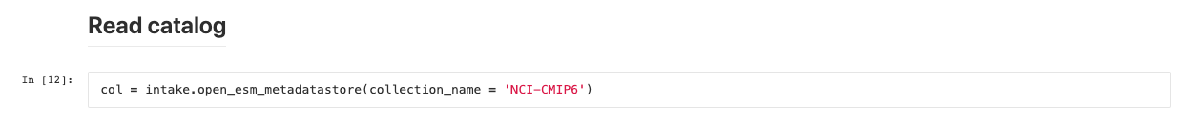
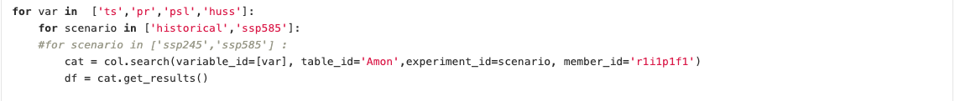
Using intake-esm
It returns a pandas dataframe with all the metadata for each file:
institute/institution_id: the institution that produced the model output (e.g. CSIRO-BOM, UNSW, etc.)
model/source_id: also refereed as source_id in CMIP6, it is the CMIP model name identifier.
experiment/experiment_id: the CMIP experiment identifier (e.g., historical, piControl, rcp45, etc.)
frequency: frequency identifier (e.g., 3hr, day, mon, etc.)
realm: modelling realm (e.g., atmos, land, ocean, etc.)
ensemble/member_id: ensemble or member_id, provides information on initialisation and physics identifier (e.g., r1i1p1, r1i1p2, etc.)
variable/variable_id: output variable
version: available versions, and 'latest' with symbolic links to the latest available version, where a version isn't available the creation date is used instead.
table/table_id: For example "Amon" is short for atmosphere monthly, "Omon" is ocean monthly, etc.
Full_path: file full path

Slide 6
NESP2.2 : The impact of global warming and the El Niño-Southern Oscillation on seasonal precipitation in Australia
We focus on June to November (i.e., southern hemisphere winter-spring) because precipitation during this period is important for agricultural production and recharging reservoirs in many parts of the country.
ENSO teleconnections: we evaluate the models on two different metrics.
Combined impact of global warming and ENSO on seasonal Australian rainfall.
Under review

Slide 7
ENSO teleconnection pattern – Australia-wide metric
Observations
Models
Models with a correlation with AWAP > 0.2 were selected.

Slide 8
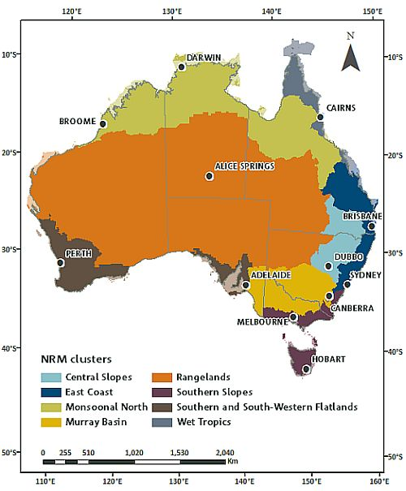
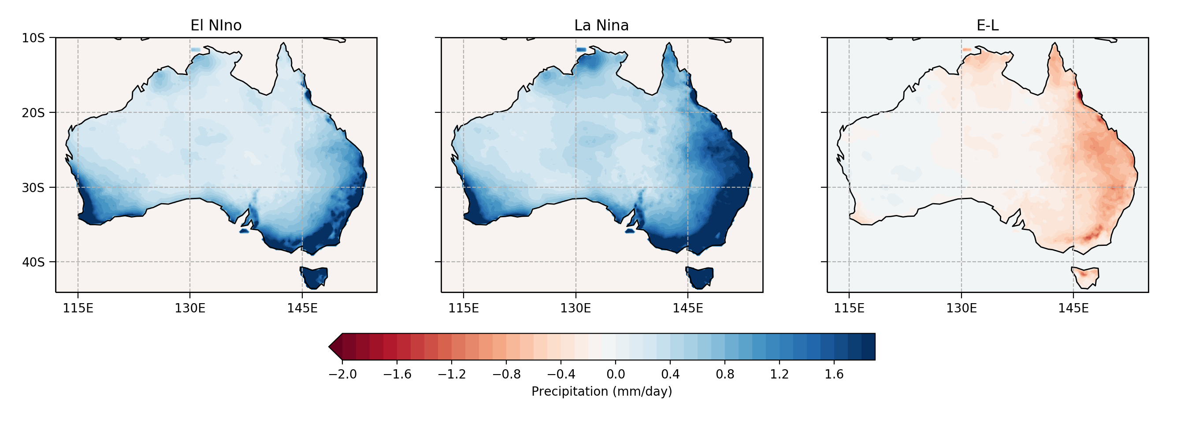
ENSO teleconnections magnitude – regional metric
Models that can reproduce the magnitude of E-L for at least 4 of the eight NRM
clusters were selected.

Slide 9
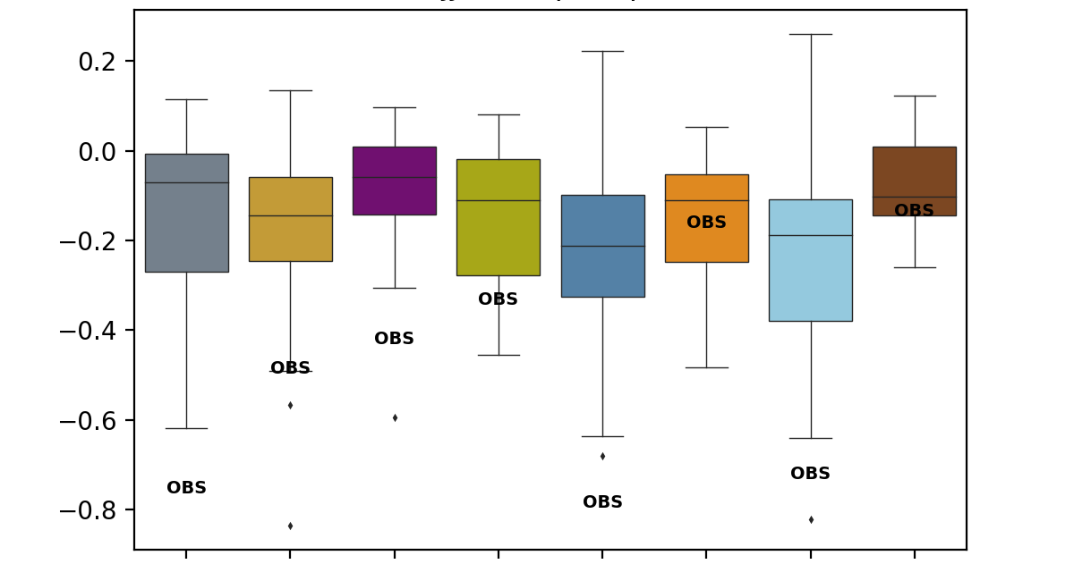
Evaluation
Magnitude
Pattern metric
Models generally do a poor job in simulating ENSO precipitation teleconnections over Australia. Only 5 models
out of 24 were selected (ACCESS1-3 , CESM1-BGC, CMCC-CMS, GFDL-ESM2M, NorESM1-M).

Slide 10
Projections
All models
Selected models (5)
An increase in ENSO-driven variability is suggested for the Wet Tropics, the Monsoonal North, the Central Slopes and
the Southern and Southwestern Flatlands.
However, given the limited number of models that exhibit skill in simulating ENSO teleconnections, these results should be regarded as hypotheses for further testing using CMIP6 models.

Slide 11
CMIP6 vs CMIP5 evaluation
Magnitude metric
Pattern metric
20% of CMIP5 Models and 53% of CMIP6 models exhibit skills in simulating ENSO teleconnections to Australian rainfall
NINO3.4 variability better simulated by CMIP6 models

Slide 12
CMIP6 vs CMIP5 Projections
CMIP6 is here.
Models first assessment look promising.
This is exciting !!!

